Slide 1

Multi-Cloud Computing
ーー to simplify and secure the operations of
a covid testing result system application

Slide 2
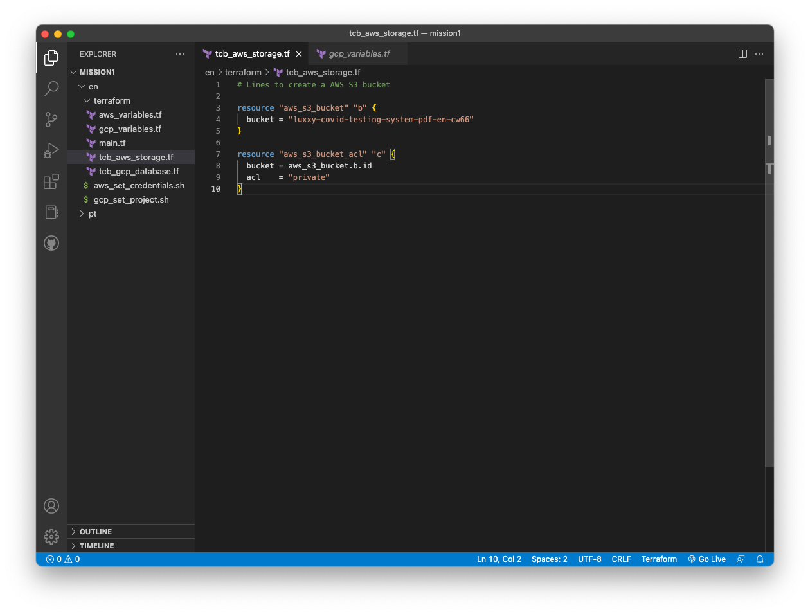
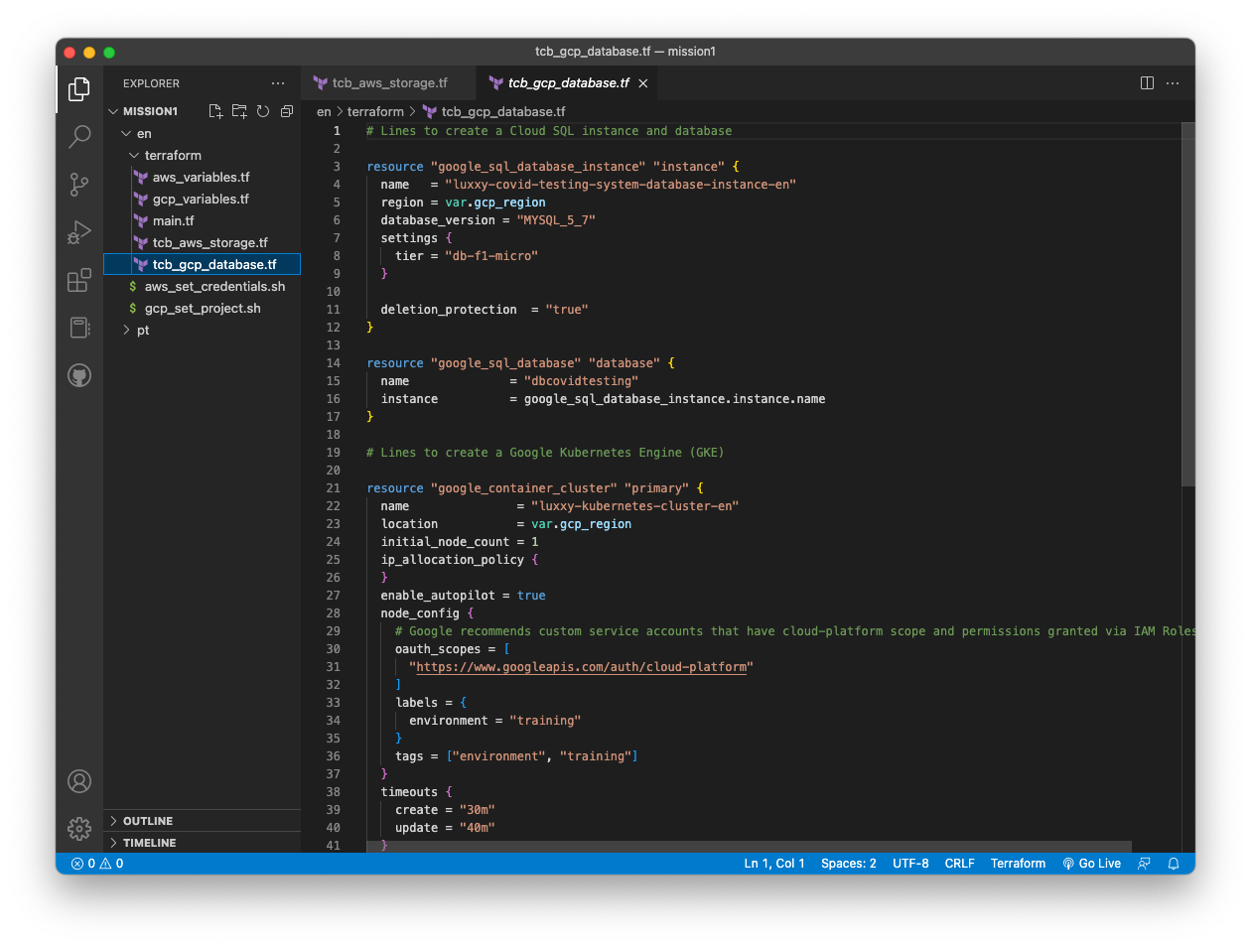
Use Terraform to create AWS S3 and GC SQL and GKE

Slide 3
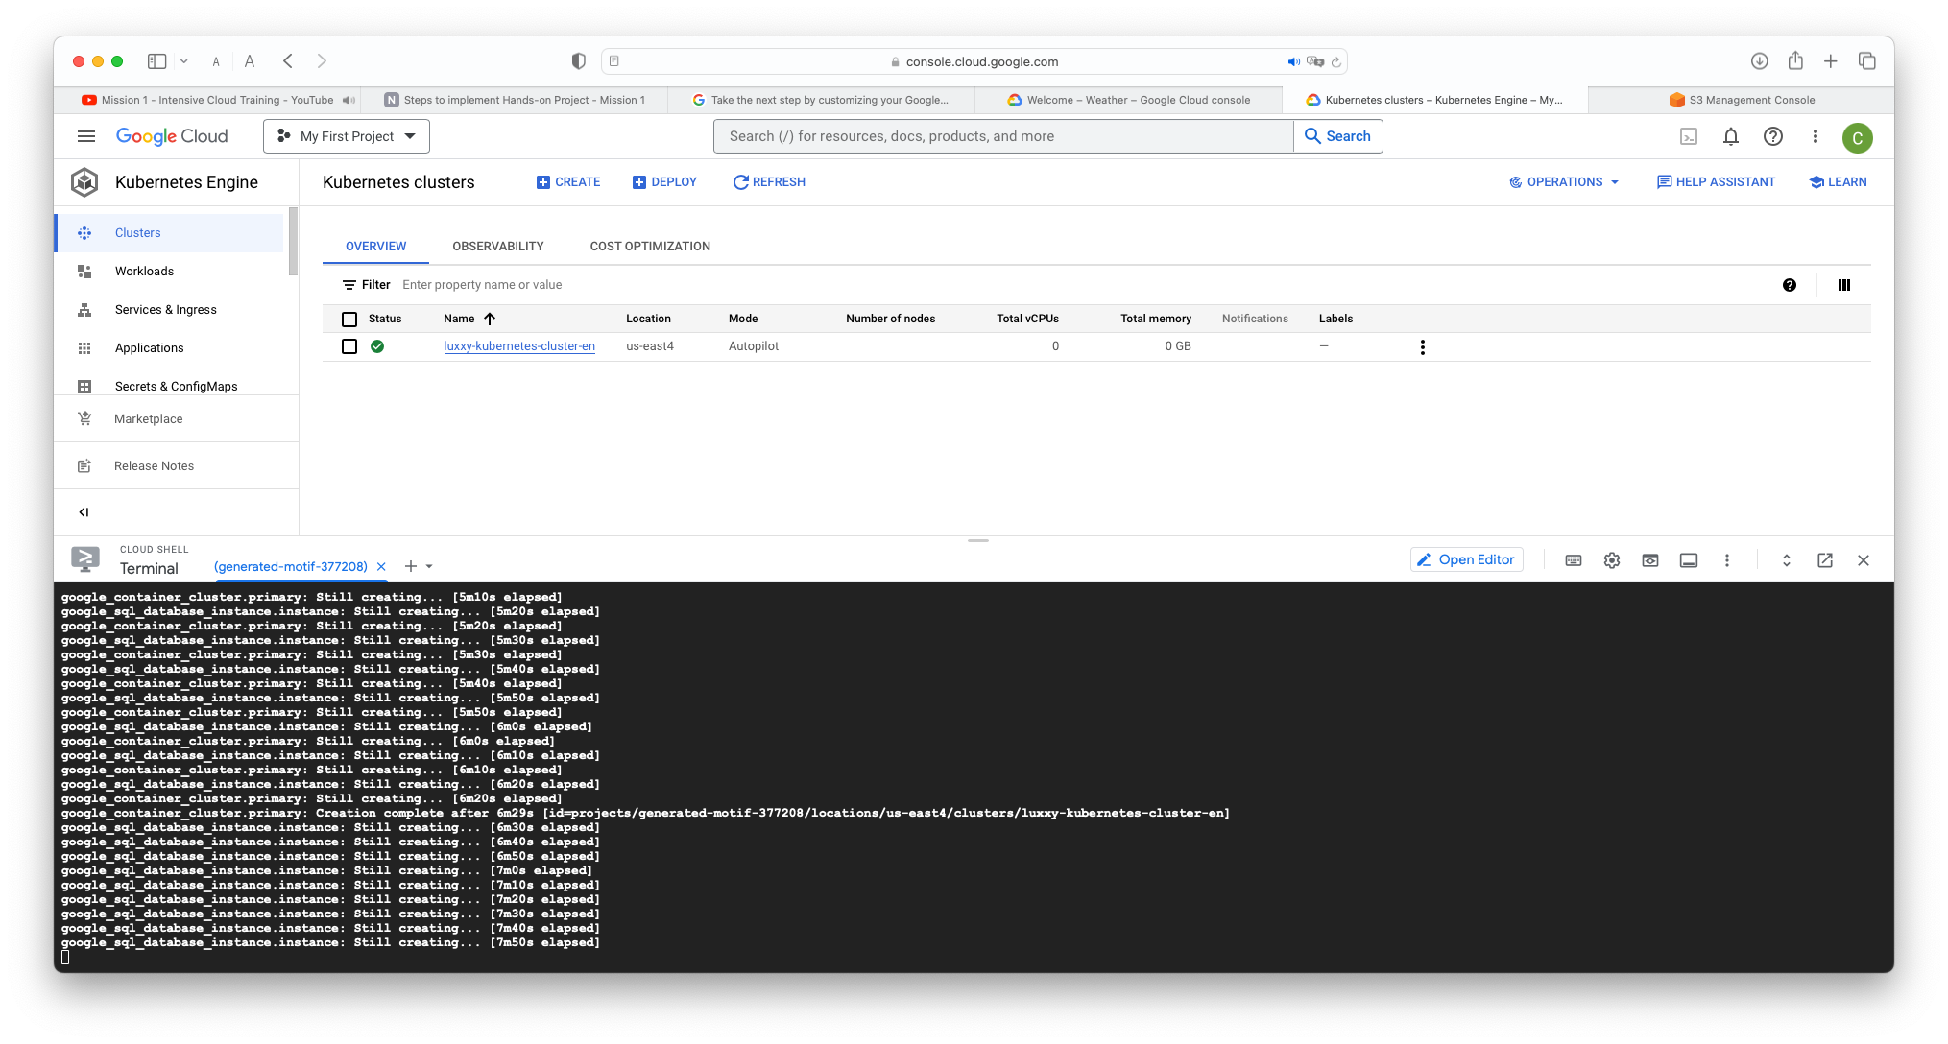
Use Terraform to create AWS S3 and GC SQL and GKE

Slide 4
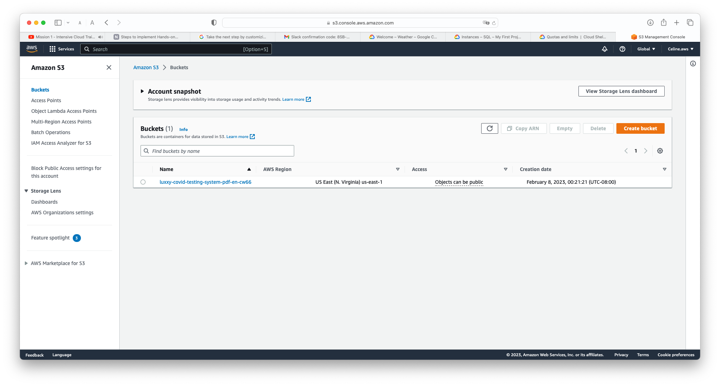
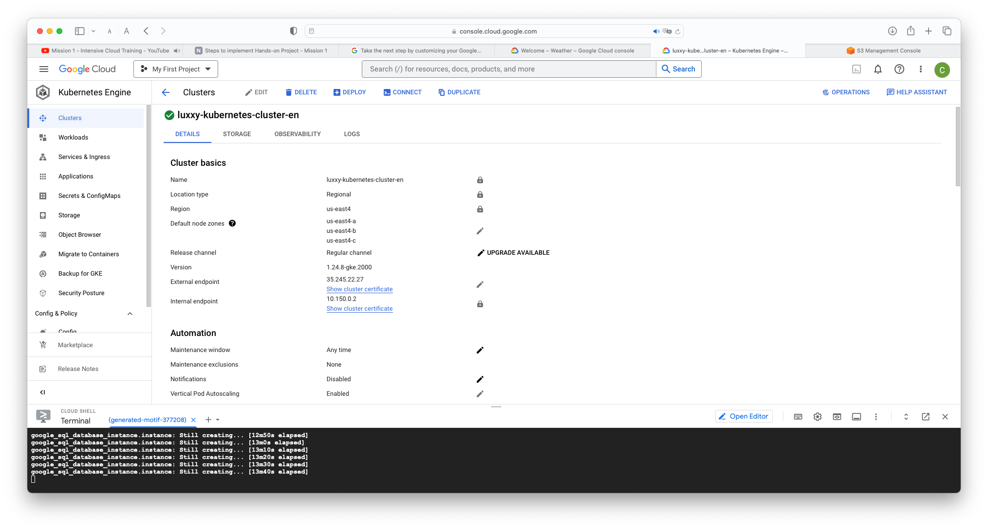
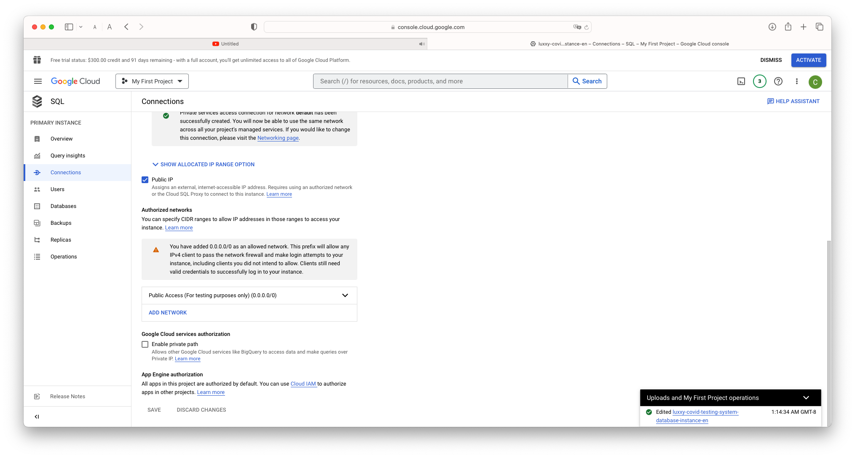
Use Terraform to create AWS S3 and GC SQL and GKE

Slide 5
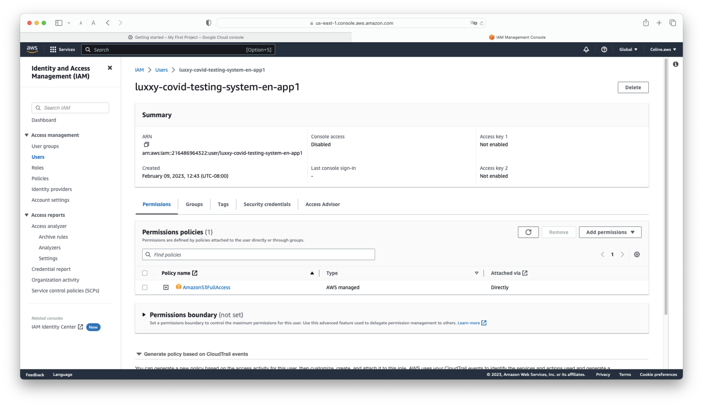
Create access key for app user on AWS

Slide 6
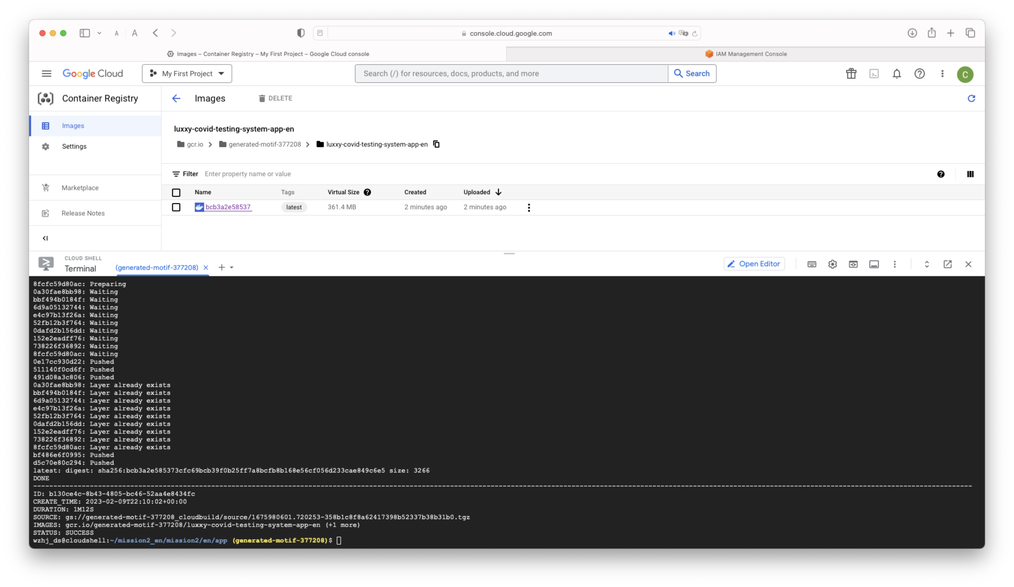
Push Docker image to GCP Container Registry

Slide 7
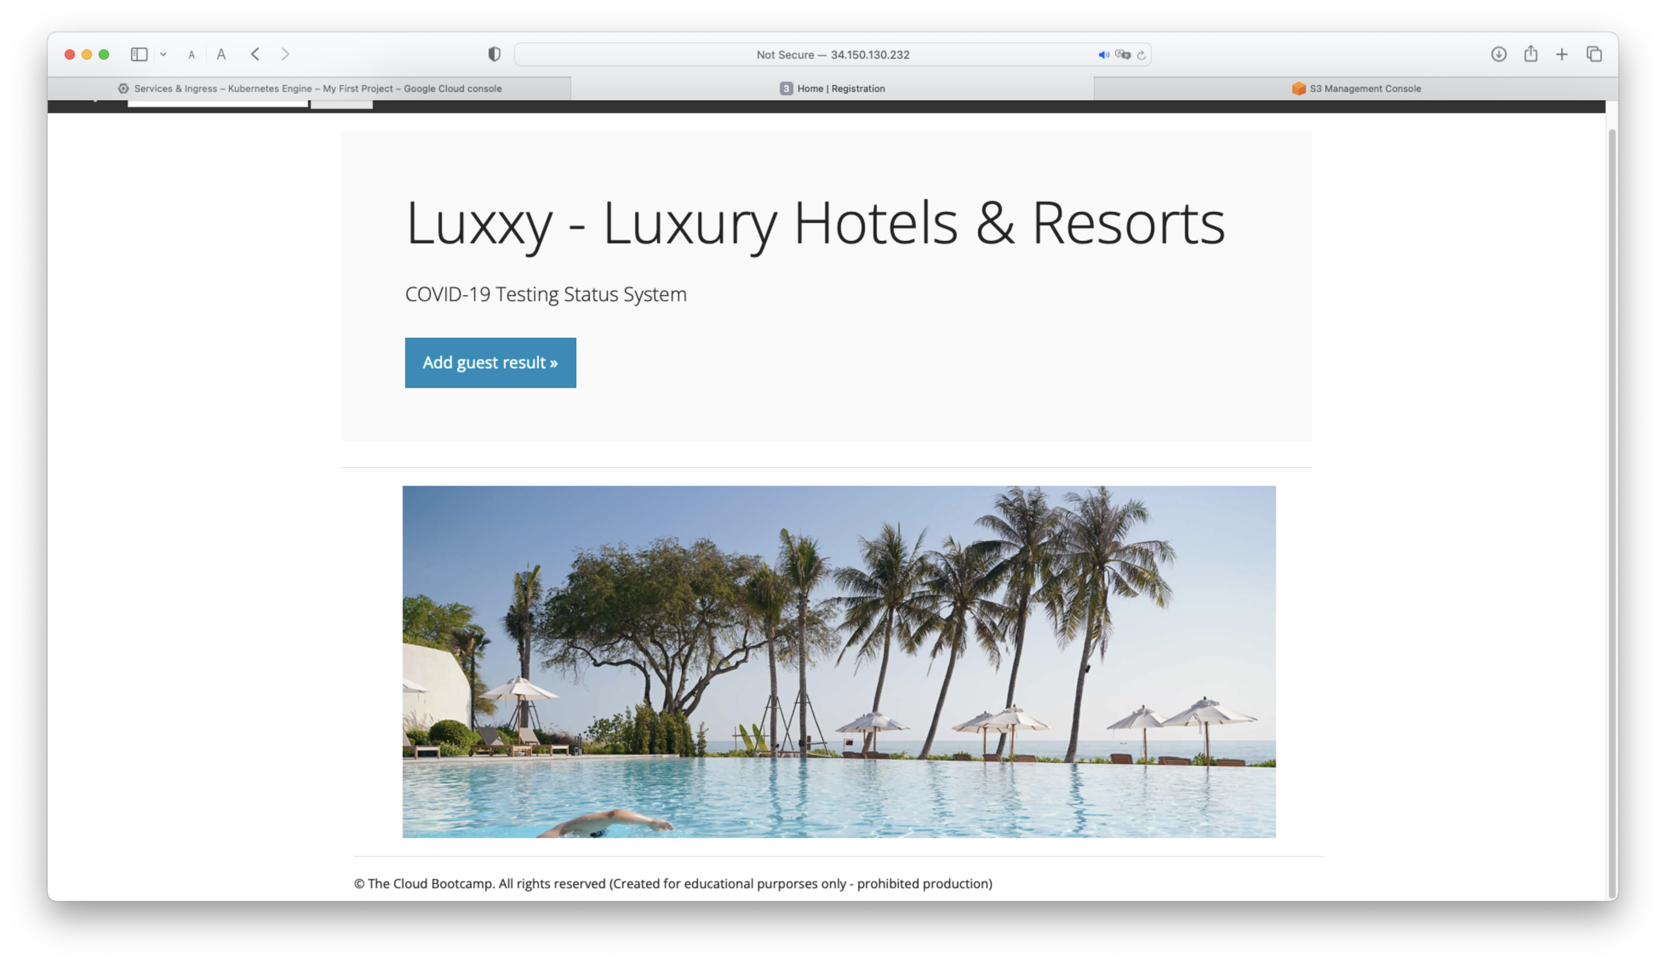
Deploy App in GKE clusters

Slide 8
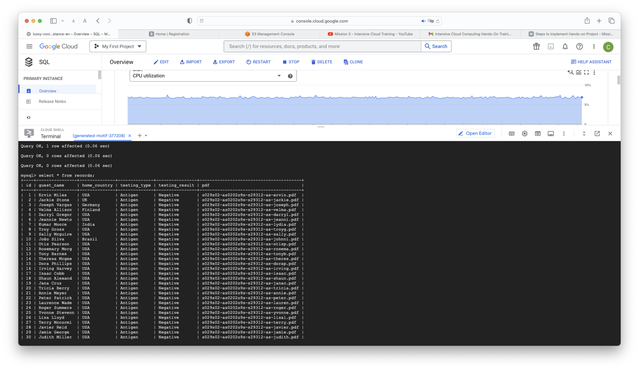
GCP database migration

Slide 9
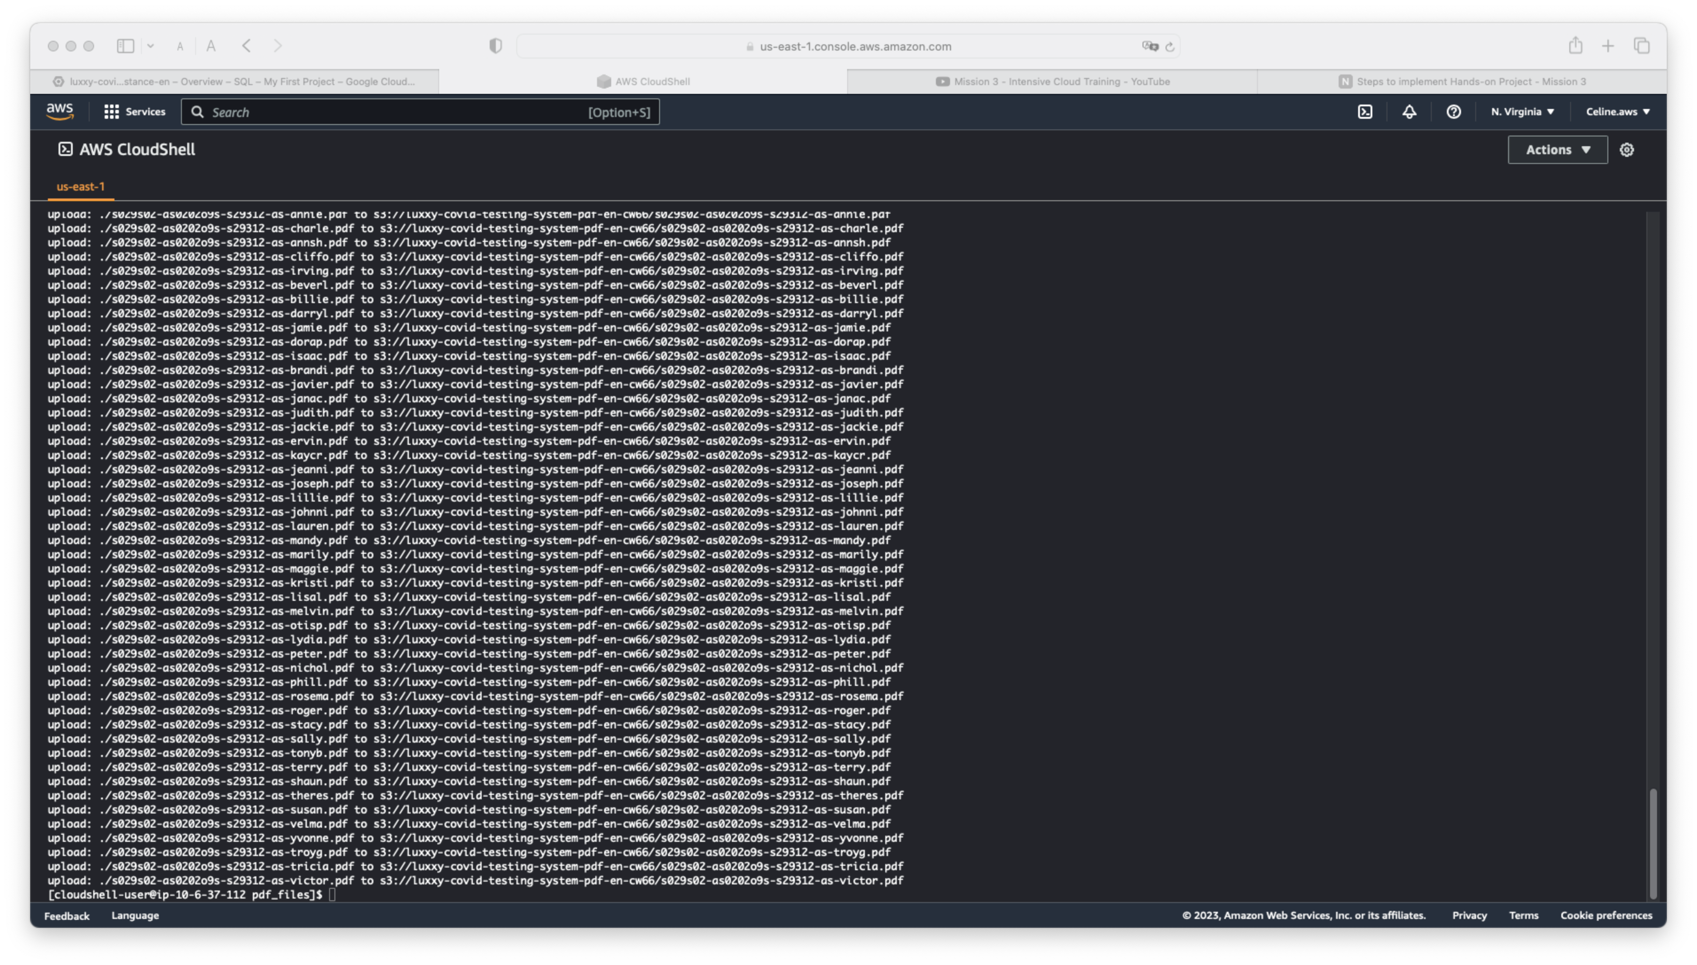
AWS PDF files migration

Slide 10
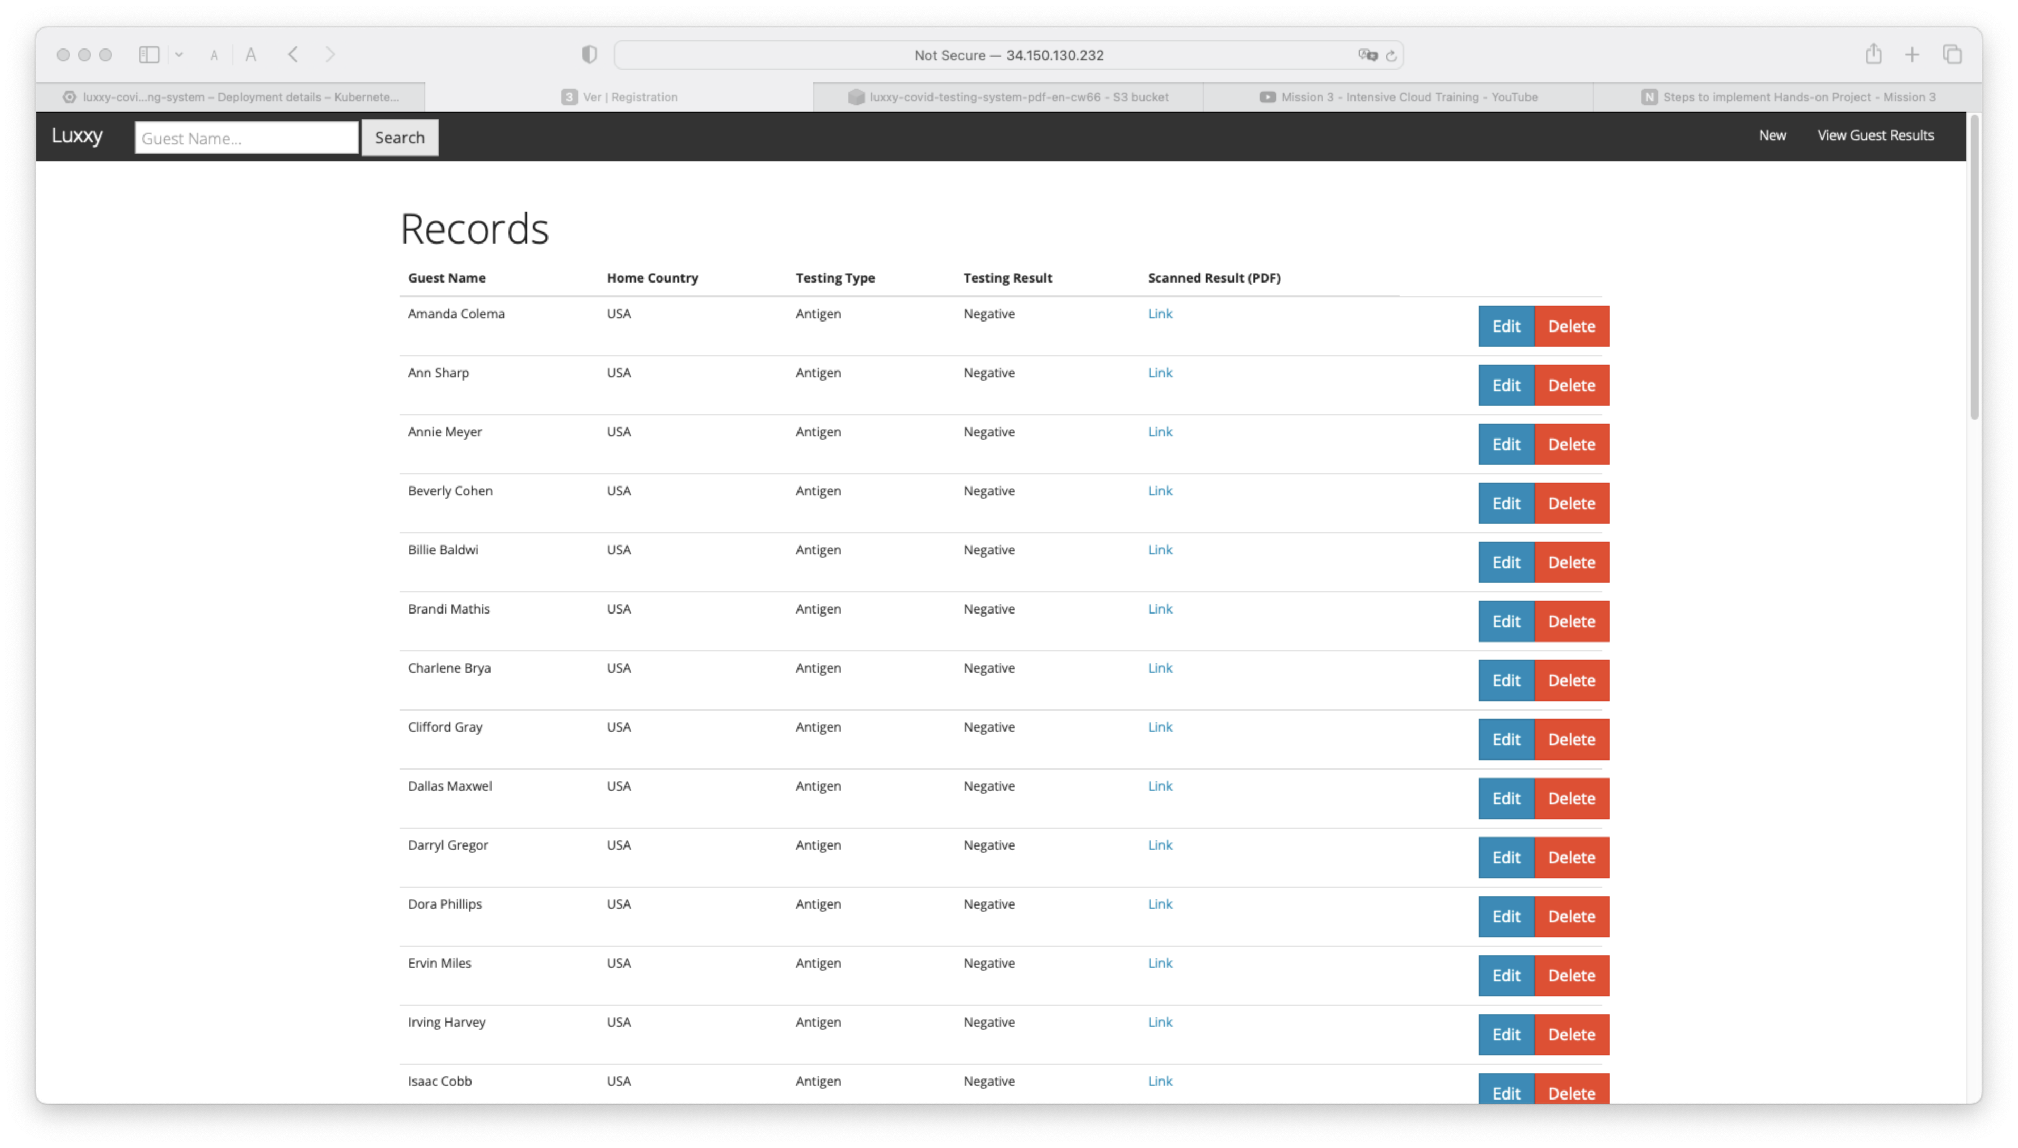
Test the Luxxy App

Slide 11
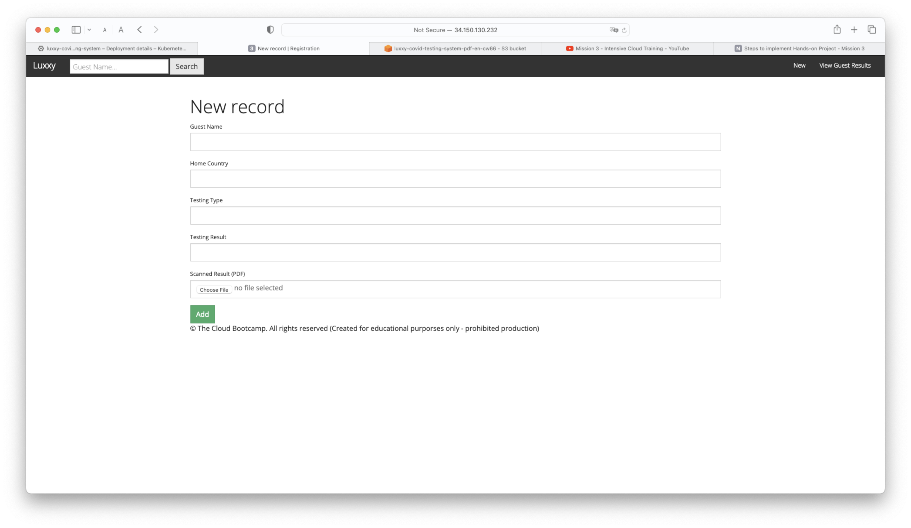
Search/Edit/Add records on the App

